Slide 1
BIG BOOTY USB
SD to USB Interface Device
Victoria Humphreys Apoorv Gaur Cameron Jones Katie Bauschka
Notes:
Apoorv
Apoorv introduces everyone!! 15 mins + 5 mins for questions
required handouts!! 3 copies of:
-slides (one per page)
-annotated printouts of simulation results - waveforms or graphical/table results
-anything else that is difficult to read on screen

Slide 2
Project Overview
What is BB-USB? An SD card to USB read/write adapter. It transmits data to and from a computer via the USB connection that is linked to the SD interface.
Why is it useful? Provides a method for devices lacking an SD slot to be able to read from and write to SD cards.
Why ASIC? Most cost efficient to mass-produce
Our Goals Small, easily portable, reliable transfer of data
Notes:
Apoorv
Why is it useful? Some computers don't have a SD card slot to allow the computer to interface directly with a SD card, but nearly all computers have a USB slot. This project will provide a method for these devices lacking an SD slot to be able to read from and write to SD cards.

Slide 3
System Design - External Interfaces
USB - 1.1 Standard
Max Transfer Rate: 12 Mbits/s
Max Packet Size: 1024 bytes
Packet Types: Handshake, Data, Token, Start-of-Frame
SD - Normal Speed
Single SPI
Speed Classes: Class 2 (2MB/s), Class 4 (4MB/s), Class 6 (6MB/s)
Notes:
Apoorv
Describe the overall architecture, operation, and external interfaces. These slides should
correspond to the System Diagram, Operational Characteristics, and Architecture sections
sd card + usb 1.1 standards

Slide 4
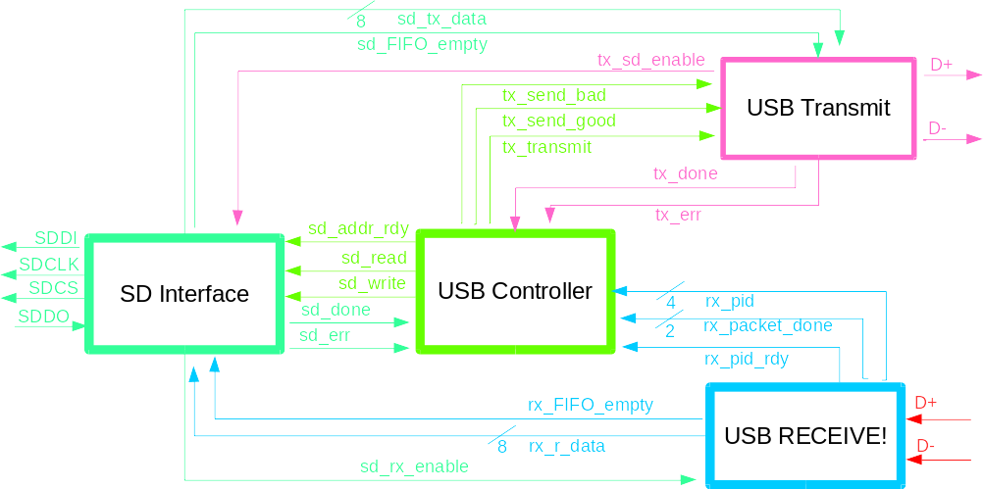
System Design - Overall Architecture
Notes:
Victoria
2 general modes - read & write
Main controller handles communication between blocks

Slide 5
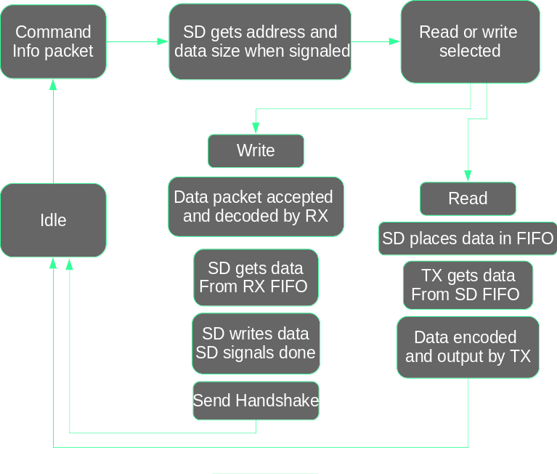
System Design - Operation Flow
Notes:
Victoria
Describe the overall architecture, operation, and external interfaces. These slides should
correspond to the System Diagram, Operational Characteristics, and Architecture sections
flowchart

Slide 6
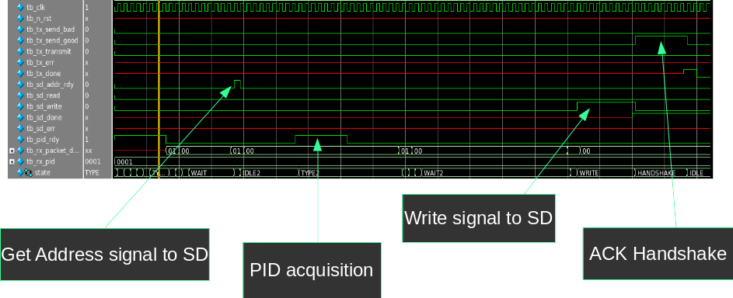
USB MCU Results - Write Cycle
Notes:
Victoria
Write cycle with shortened write time

Slide 7
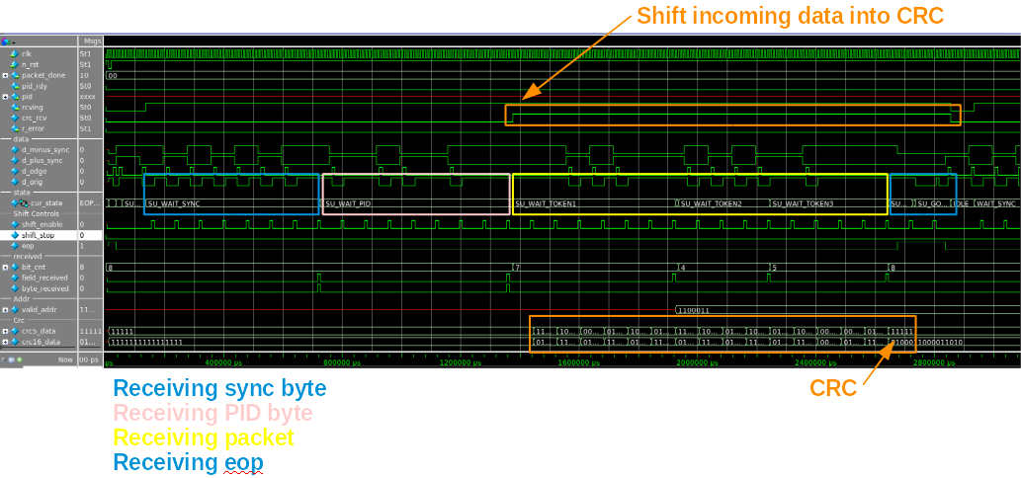
USB Rx Results - Receiving a Setup Token
Notes:
Katie
This shows the processes of receiving a setup token. This process is the first one that must occur on startup. If other packets are received before setup, the USB receiver ignores them. After a successful sync byte and PID byte, 7 bits are received, which make up the data address to be used for succeeding token packets. Two more bit periods occur, the last of which is the CRC value. At an eop, the value in the crc register is checked to be an inverted instance of 0 (11111 -> 00000). Should the CRC value check out, the program moves into the normal idle state, where it waits to receive more packets.
Note the crc_rcv signal is only asserted when data should be shifted into the crc registers.

Slide 8
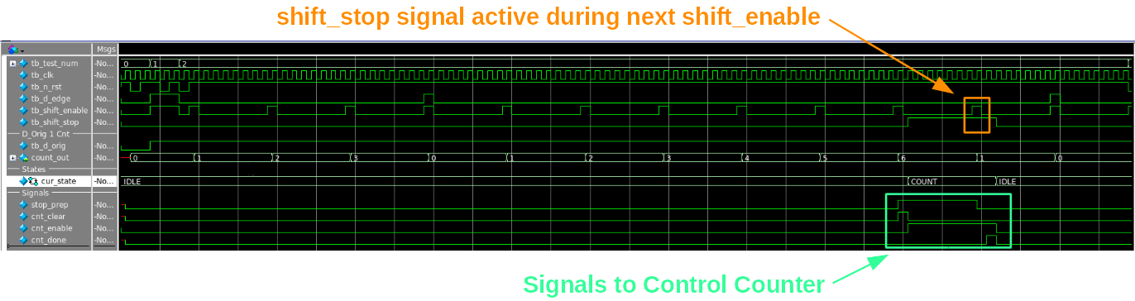
USB Rx Results - Bit Unstuff Signals
Notes:
Katie
This shows the proper behavior of bit_unstuff signals. When d_orig is 1 on a shift_enable, a counter is incremented. Should this counter reach 6, a state transition occurs, enabling a secondary count of clock cycles. While waiting for the count to complete, a shift_stop signal is asserted, and remains asserted through the next shift_enable. When the counting sequence finishes, the count of 1’s begins again. Should a d_edge be detected, the count of 1’s is reset (unless already in clock cycle counting state).

Slide 9
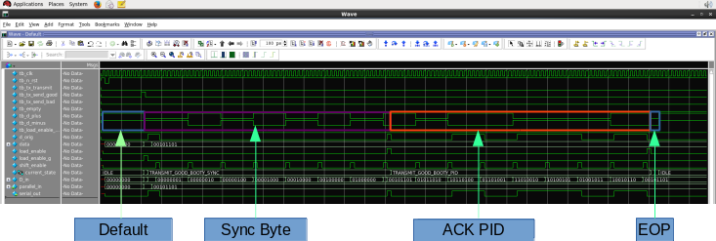
USB Tx Results - TX Good Handshake Packet
Notes:
Apoorv
most important test results slide 4 - primary intended feature

Slide 10
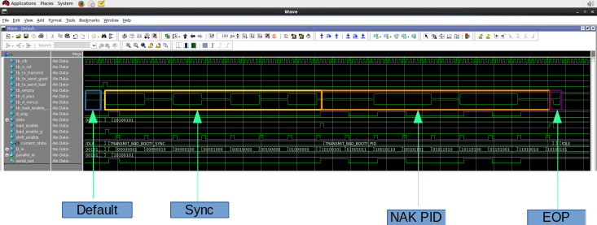
USB Tx Results - TX Bad Handshake Packet
Notes:
Apoorv
most important test results slide 4 - primary intended feature

Slide 11
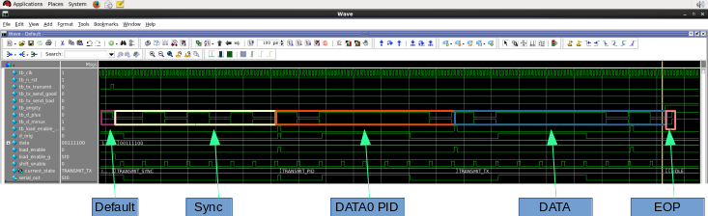
USB Tx Results - TX Transmit Packet
Notes:
Apoorv
most important test results slide 4 - primary intended feature

Slide 12
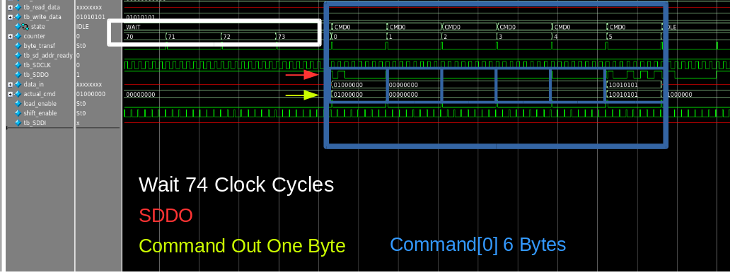
USB SD Results - SD Sends Commands
Notes:
Cameron
most important test results slide 2 - primary intended feature
at least 2 needed, can have up to 4

Slide 13
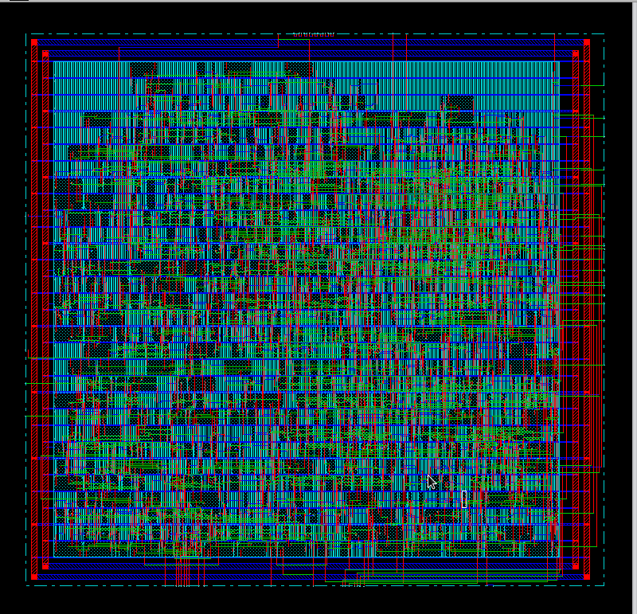
Results - Layout
Estimated SD Area
5.16E5 um² (No pads, no FIFO)
Current Layout SD Area
1.00E6 um² (No pads, no FIFO)
Design Optimization
SRAM to save on area
Notes:
Cameron
things went wrong and we couldn’t get the things to have pads
design optimization - MAJOR DECISION TO USE SRAM - mostly used standards set by USB and SD

Slide 14
Results - Fixed Success Criteria Status
Test benches exist for all top level components and the entire design.
Design synthesizes without latches, timing arcs, and warnings.
Source and mapped version of the complete design behave the same.
The IC layout passes all geometry and connectivity checks.
Targets:
Area - Approx. 2.61mm x 2.61mm
Pin Count - 8
Clock Freq - 96 MHz
Notes:
Cameron
Things in green need to be done or fixed

Slide 15
Results - Design Specific Success Criteria Status
Single block write requests to SD.
Single block read requests from SD.
Bulk transport of data packets from USB to SD works.
Rx receives 4 different packet types and correctly unstuffs data.
Tx sends 2 different packet types and correctly stuffs data.
Data blocks are correctly read and written to SD at all designated speed ratings.
Notes:
Katie
(1 pt) The USB to SD interface can correctly handle single block write requests. Data is held in only one data packet (of 0-1023 bytes). Setup works, but there is no tested FIFO/SRAM to write data to.
(1 pt) The SD to USB interface can correctly handle single block read requests. Data is held in only one data packet (of 0-1023 bytes).
(1 pt) Demonstrate by simulation of a Verilog test bench that the bulk transport of data packets to and from USB/SD works. Data is held in multiple data packets (of 0-1023 bytes). Entirely missing.
(2 pts) Rx correctly receives 4 different packet types and correctly unstuffs data. A setup token packet is accepted correctly, the remaining tokens should be as well. SOF should work by extension, and the lab 6 code worked.
(1 pt) Tx correctly sends 2 different packet types and correctly stuffs data.
(2 pts) Data blocks are correctly read and written to SD at all designated speed ratings. Currently only writes/reads at one speed (2 MB/s).

Slide 16
Conclusions
Biggest Challenges
Debugging, Bit Stuffer, CRC Blocks
Alternative Approach
Use SD Mode instead of SPI, Better time management
Desired Improvements
SD CRC checking, USB 2.0, Higher speeds
Notes:
Katie
Biggest challenge was understanding the concepts behind the design. Things like bit stuffing and crc’s were hard ideas to grasp, and then turn into programmable code. We also ran into a problem with debugging out code, specifically mapped code and layout designs.
An alternative approach is to use the SD mode instead of the SPI, meaning we would send 4 bits of data at a time instead of a serial transmission of one bit at a time. A better use of time management would also be nice if we did this again. There were several sections that turned out to go faster than others, and other sections that ended up taking a lot of time. A more forwardly progressive schedule, rather than a week-by-week task list.
If we had more time to work on the project, some desired improvements would be checking the crc values within the SD interface, bumping up to a new version of USB, like 2.0 or 3.o, and in general having the design run at higher speeds.

Slide 17
Questions?

Slide 18
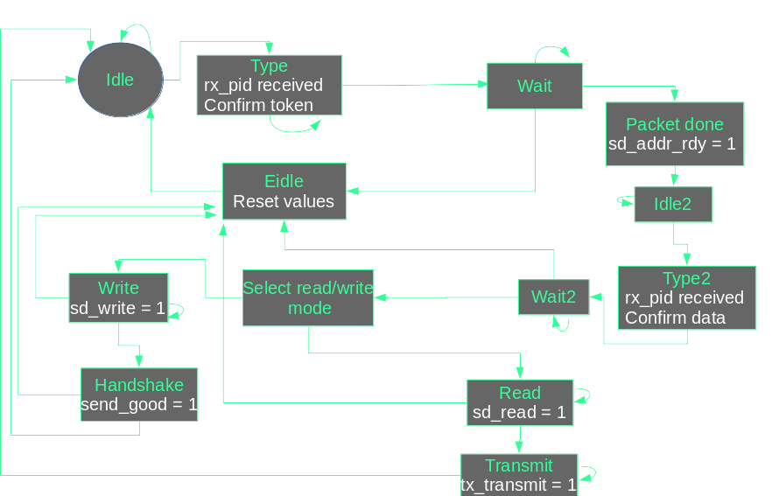
For Questions - MCU State Diagram
Notes:
Victoria
lower level diagrams for use in question answering if needed

Slide 19
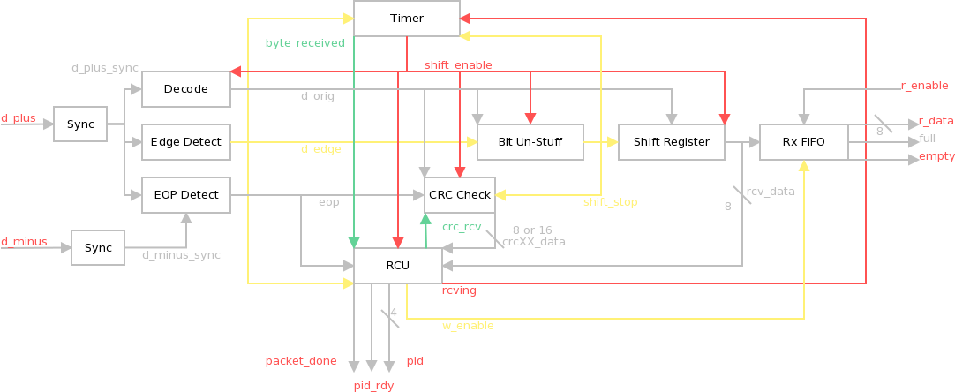
For Questions - RX Block Diagram
Notes:
Katie
Top Level Block Diagram for USB Rx Block. Red signals on the outermost edges are ones that reach to the MCU.
Bit Unstuff - Lookes at d_orig for repeated occurrences of 1’s. If 6 1’s are counted, the shift_stop signal is asserted and sent to bit-conscious blocks (timer, shift_register, crc_check).
CRC Check - Takes in the data from a packet, not including sync, pid, or eop. Handshake packets do not have a crc value. There are two instances of the CRC Check, one 5 bits wide, one 16 bits wide.

Slide 20
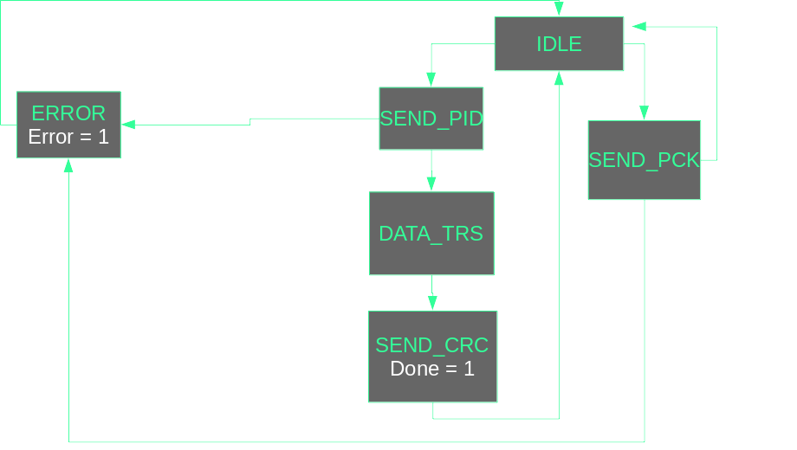
For Questions - TX Block Diagram
Notes:
Apoorv
lower level diagrams for use in question answering if needed

Slide 21
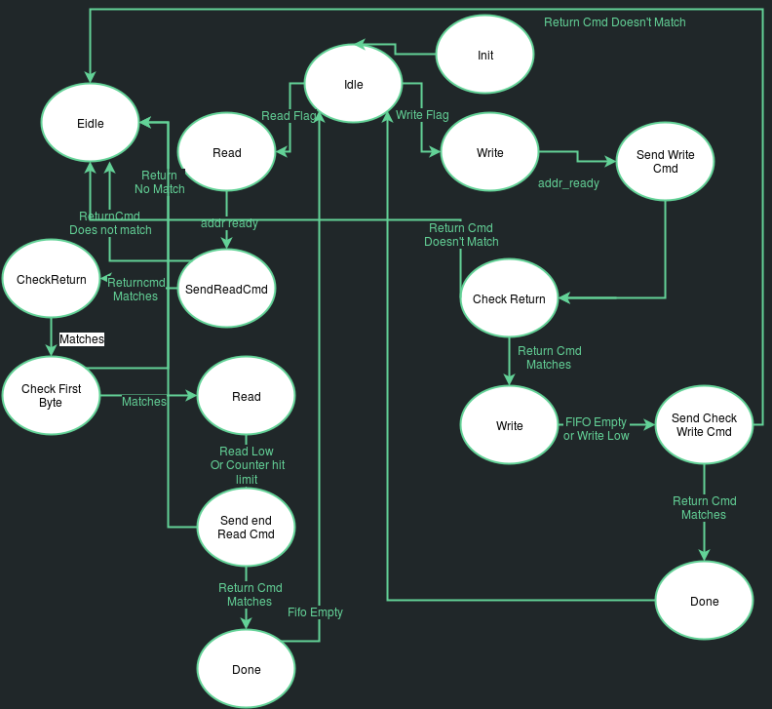
For Questions - SD State Diagram
Notes:
Cameron
lower level diagrams for use in question answering if needed

Slide 22
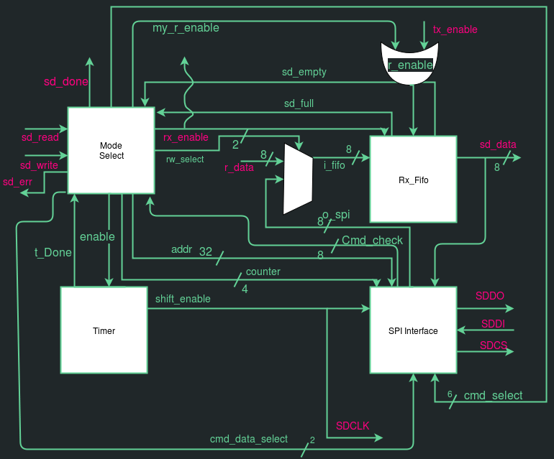
For Questions - SD Block Diagram
Notes:
Cameron
lower level diagrams for use in question answering if needed

Slide 23
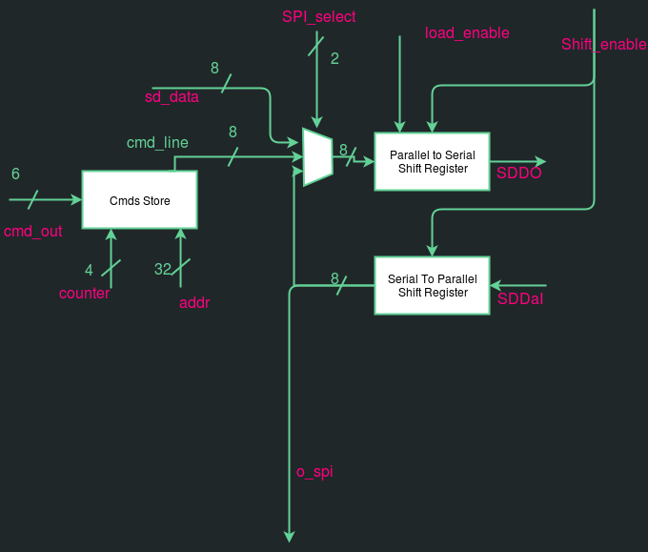
For Questions - SD SPI Diagram
Notes:
Cameron
lower level diagrams for use in question answering if needed

